Slide 1

PayPal Clone
(Lightning Web Component)
CAPSTONE PROJECT
Vincent Michael M. Berdera

Slide 2


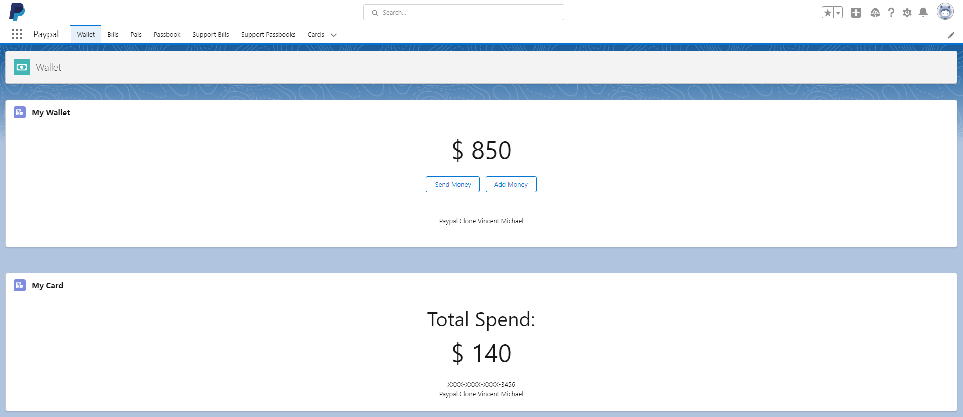
On Wallet Page, if the system found an existing wallet record related to the user it will display the balance and the name of the user at the bottom of the buttons. If the system did not found a record it will display a field for user to create a wallet record. User will be able to edit the record once and after refresh the user can’t edit the record anymore.

Slide 3
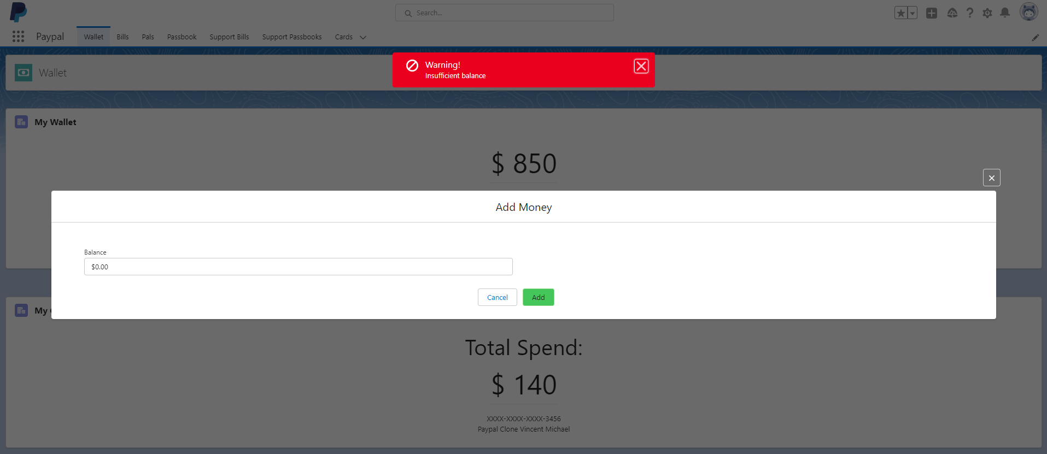
If User click the Add Money button it will randomly display a message saying that his wallet doesn’t have enough balance.

Slide 4

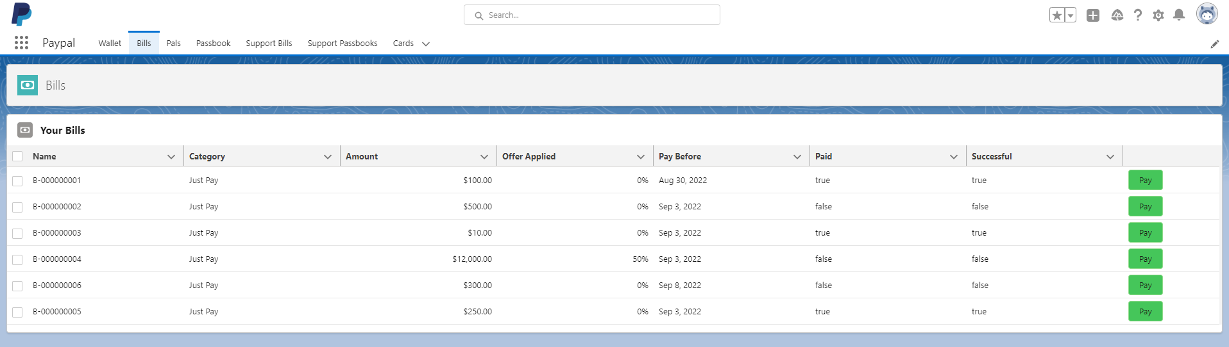
In Bills Page, all bills records related to User will be displayed in tabular form. It will also contain a Pay button in each row that once clicked it the paid field will be true.

Slide 5
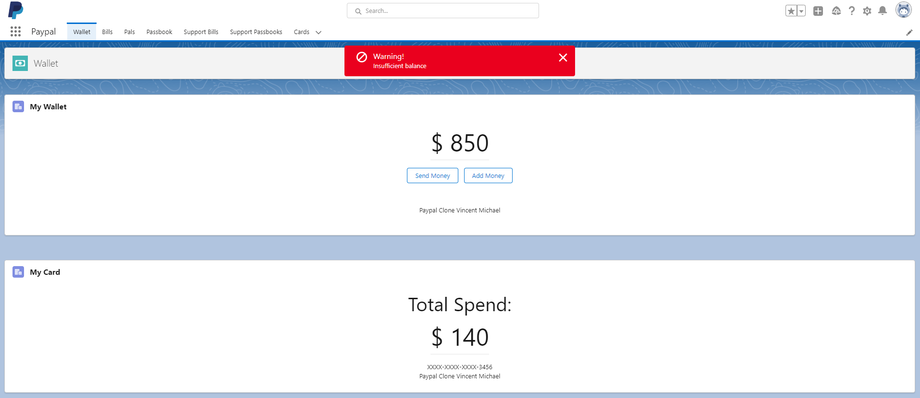
In Bills Page, if you click the Pay button and your wallet don’t have enough balance to pay that bill, it will route you to you wallet page to Add Money first and it will also display a message saying “Insufficient balance”

Slide 6
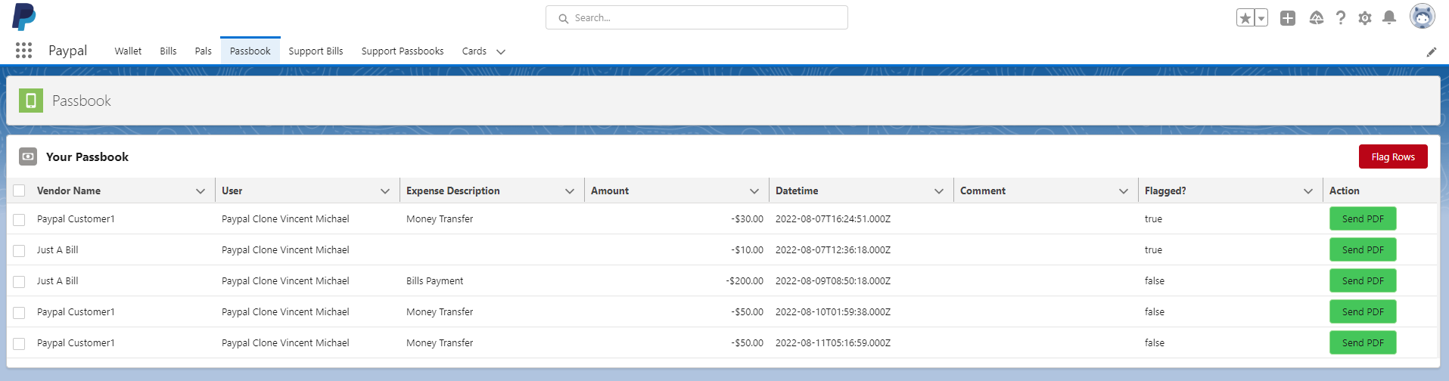
If the User successfully paid his bill, the system will automatically generate a new record on the passbook regarding the transaction.

Slide 7

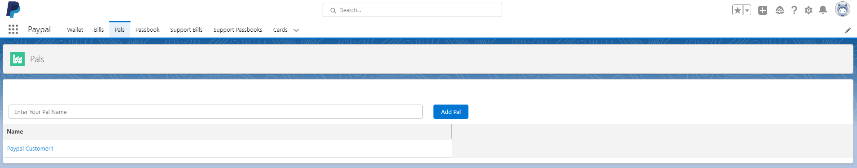
If the User clicked the Send Money button, it will route the User to a different page where he can check all his pal that is related to his/her account. On Pals Page there will be a search button to search for his pal.

Slide 8
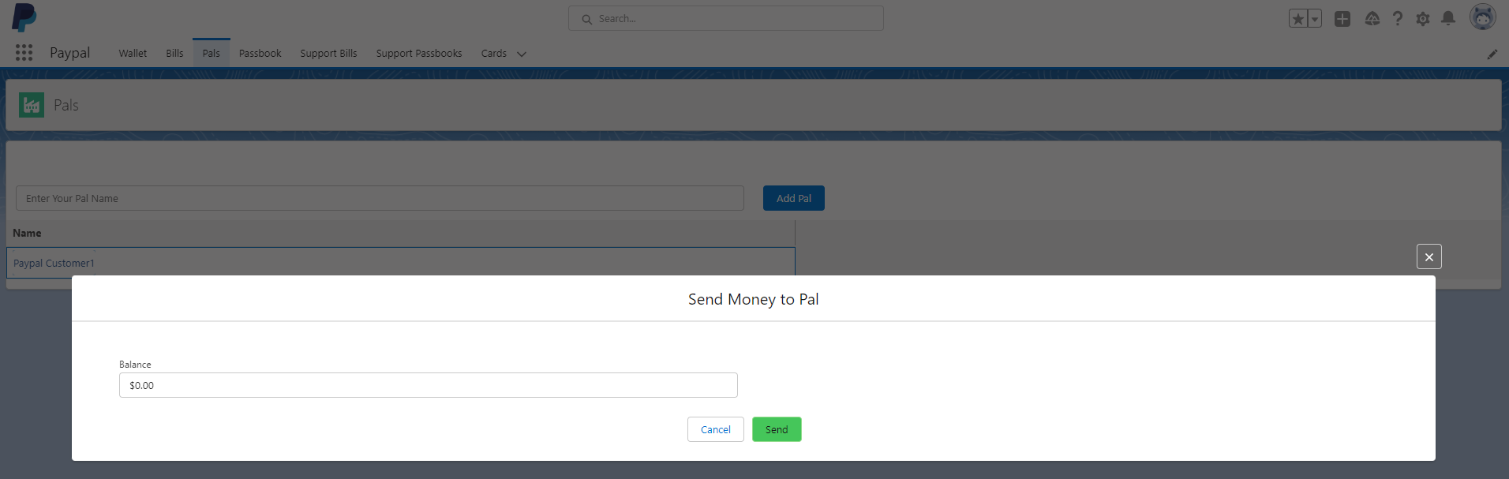
In Pals Page, if the user clicked the Pal that he/she wanted to send a money, it will display a pop-up modal asking the amount of money he/she wanted to send.

Slide 9


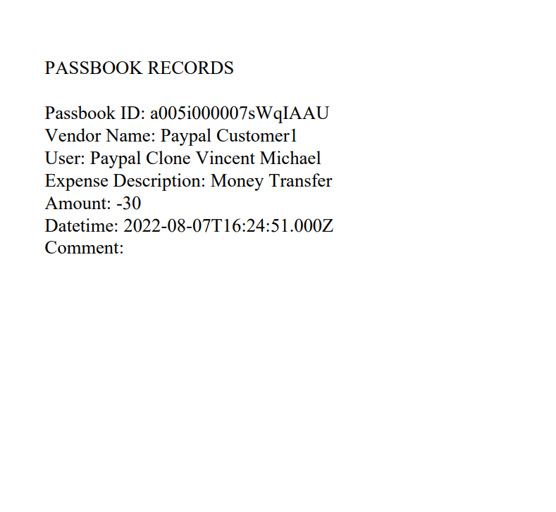
In Passbook Page, the system will display all the records related to the user and in each row there will be a button to send a PDF copy of the user transaction on his/her email.

Slide 10
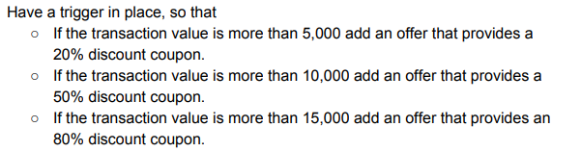
Once the admin created a bill for the users, the system will trigger an automation to generate a discount coupon for that specific bill.

Slide 11
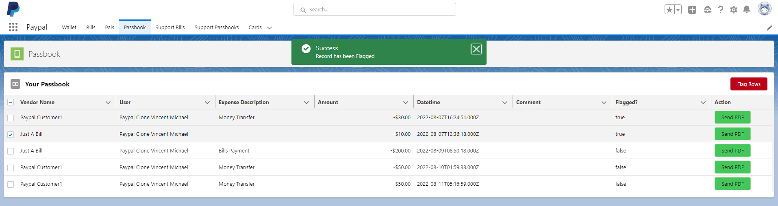
The user can flag a transaction if they think there are problems on it. They can do this by simply selecting the rows checkbox and then click the Flag Rows button. This will prompt the system to flag the transactions so the support team can take a look on the transaction/s.

Slide 12

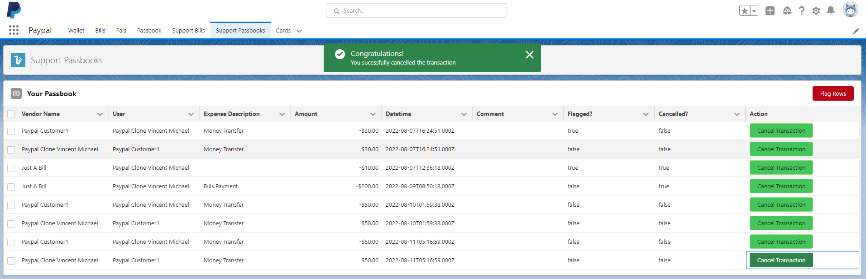
The admin or system support can cancel any transaction even if it’s a finished transaction. The admin can do it by simply clicking the Cancel Transaction button. This will cause the system to mark the transaction as cancelled and also return the money to the user.

Slide 13
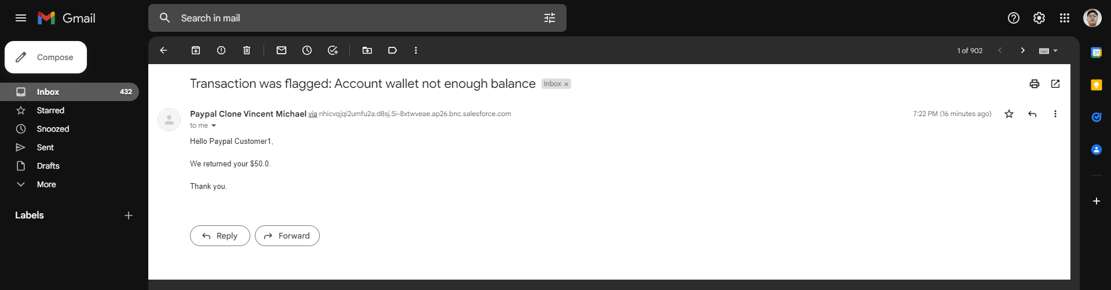
If the admin clicked the Cancel Transaction button and the system found out that there is not enough balance on the receiver. It will send a message to the receiver.

Slide 14

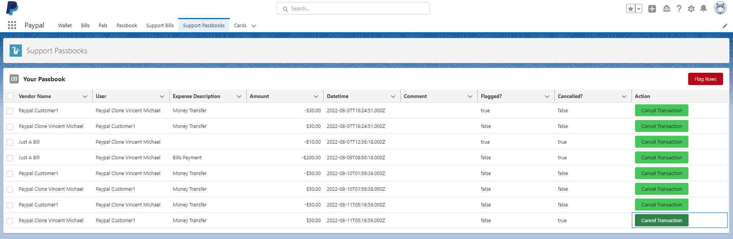
Same as users, admin can also flag the transaction of they believe they need to review a specific transaction. The buttons that will only available for the admin is Cancel Transaction button and Flag Rows button for them to flag the transaction. Send PDF button is something that is not for the admins.

